Slide 1
Internship project
Estimation and prediction of hospitalization and medical costs

Slide 2
TEAM ID : LTVIP2023TMID04037
TEAM MEMBERS:
1) Jyothula Divya Sai Sree - CSE-AI&ML
2) Merneedi Chakradhar - CSE-AI&ML
3) Yannam Harish Reddy - CSE-AI&ML
4) Potla Manikyam - CSE-AI&ML
5) Katiki Sanjaykumar - EEE

Slide 3
INTRODUCTION ABOUT THE PROJECT
Medical costs are one of the most common recurring expenses in a person’s life. Based on different research studies, BMI, ageing, smoking, and other factors are all related to greater personal medical care costs.
The estimates of the expenditures of health care related to smokers are needed to help create cost-effective smoking prevention strategies.
Due to smoking the chances of obesity will also increases
Obesity prevention at a young age is a top concern in global health, clinical practice, and public health. To avoid these restrictions, genetic variants are employed as instrumental variables in this research.
Using statistics from public huge datasets, the impact of body mass index (BMI) on overall healthcare expenses is predicted
Fast-growing healthcare costs have become a significant challenge in several developed countries. Existing evidence suggests that healthcare costs have accumulated among a large number of BMI.

Slide 4
Now a days hospitalization costs are included in everyone’s life in the name of many health issues called lung diseases, obesity, heart problems, skin issues, hair issues, and many more so every one are suffering with some problems and they need to visit hospital for solving those issues
As the need of hospitalization is increased, the costs of everything became high. So in this project we are dealing with the project called estimating and predicting of hospitalisation and medical costs
To find this medical costs of hospitals we are analysing the data to get clear about the medical costs
Now a days as per modern studies the maximum problems are mainly caused by the smoking and the lung diseases are increasing only because of the smokers
Because of smokers each and everyone in the society has to face the issues and only because of them the hospital needs are becoming more and more..

Slide 5
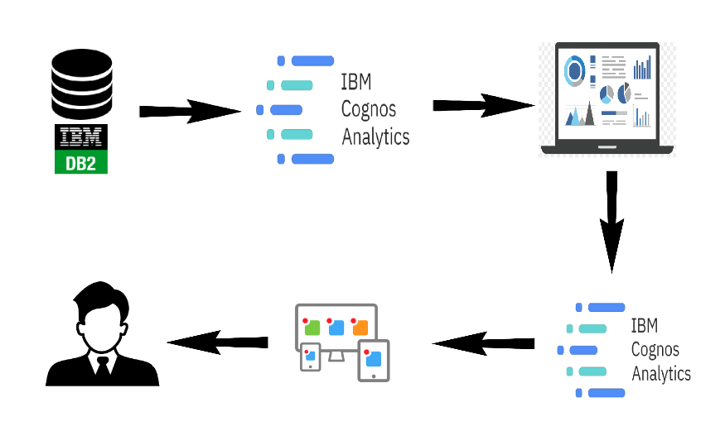
Technical Architecture Regarding Project

Slide 6
Smokers, the obese, have markedly higher health-care costs than peers
A new study finds that smokers and the obese ring up substantially higher annual health care costs than their nonsmoking, non-obese peers. The added costs are highest among women, non-Hispanic whites and older adults, the study reports.
These numbers reflect the added costs of obesity and smoking above the average annual health care expenditures of non-obese and nonsmoking
Out-of-pocket medical expenses, inpatient and outpatient care, emergency room visits and prescription drugs all contribute to the added health care expenditures, with inpatient prescriptions contributing the most

Slide 7
The added costs were not only large but also increased substantially over the last decade," he said. Health care costs associated with obesity increased by a quarter and those linked to smoking rose by nearly a third from 1998 to 2011
Pharmaceutical expenses associated with obesity and smoking were 62 percent and 70 percent higher (respectively) in 2011 than in 1998.
For obesity, the added medical expenses were highest among those with the highest body mass index, An reported. And, as expected, older adults with longer smoking histories had "substantially higher medical costs (than) their younger counterparts”.
The new study analyzed only health care-associated expenses, not costs to employers and to society that result from absenteeism or reductions in productivity.
"Cost estimates of this study only pertain to short-term health consequences of obesity and smoking,"

Slide 8
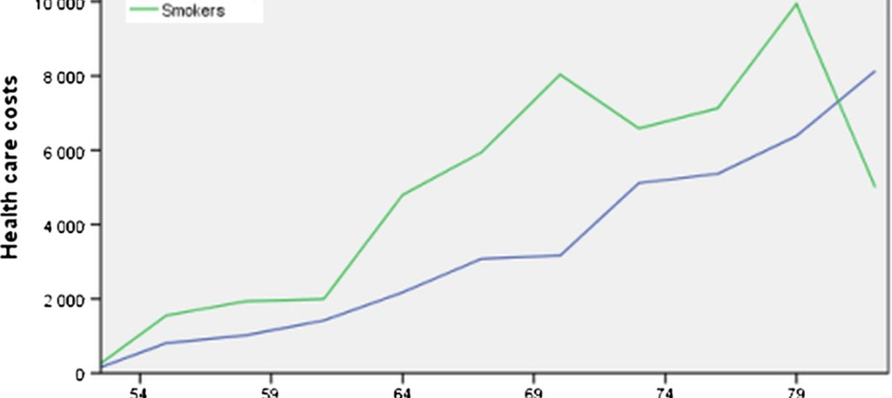
Graph shows about information of smokers
The smokers have increased largely the non smokers are less when compared to non-smokers. In the above graph the green line indicates the smokers and in that graph we can see clearly thet the number of smokers are increasing day by day.

Slide 9
Smoking is the single most important preventable cause of premature death in industrialised countries, and tobacco taxation is still the most cost-effective method for decreasing the prevalence of smoking
Increases in tobacco taxes have encouraged 9–17% of smokers to quite, and in the long run the main effect of taxation is a reduction in the incidence of new young smokers.
Early smoking cessation increases lifespan by about 9–10 years, and if the smoking rate diminished by 10 percentage points, life expectancy would increase by about 1 year.
It has been estimated that a 10% increase in the price of smoked tobacco will result in about a 5% decrease in cigarette consumption, yet tobacco taxes are still low in many countries.
The net effect of smoking on healthcare costs has been investigated in several studies. Some modelling studies have suggested that although smokers suffer more from many kinds of diseases, non-smokers incur more healthcare costs because they live longer

Slide 10
A subject was defined as a smoker if he had ever smoked on a regular basis, and had smoked cigarettes, cigars or a pipe within the past 30 days.
The lifelong exposure to smoking (‘cigarette pack-years’) was estimated as the product of years smoked and the number of tobacco products smoked daily at the time of examination
‘Years smoked’ were defined as the sum of years of smoking regardless of when smoking had started, whether the subject had stopped smoking, or whether it had occurred continuously or during several periods.
The amount of paid tobacco taxes was estimated on the basis of cigarette pack-years, and the amount of paid income taxes was estimated by using the income tax rate for the year 1987.
The amount of occupational productivity and income taxes lost was calculated as the difference of age at retirement (relative to the retirement age of matched non-smokers) multiplied by the annual income and income tax of each smoker. ‘Income taxes paid’ also included obligatory pension and healthcare insurance fees.
Smokers had substantially lower mean BMI and educational level. Smokers also had a slightly lower mean systolic blood pressure and a slightly higher mean LDL cholesterol level

Slide 11
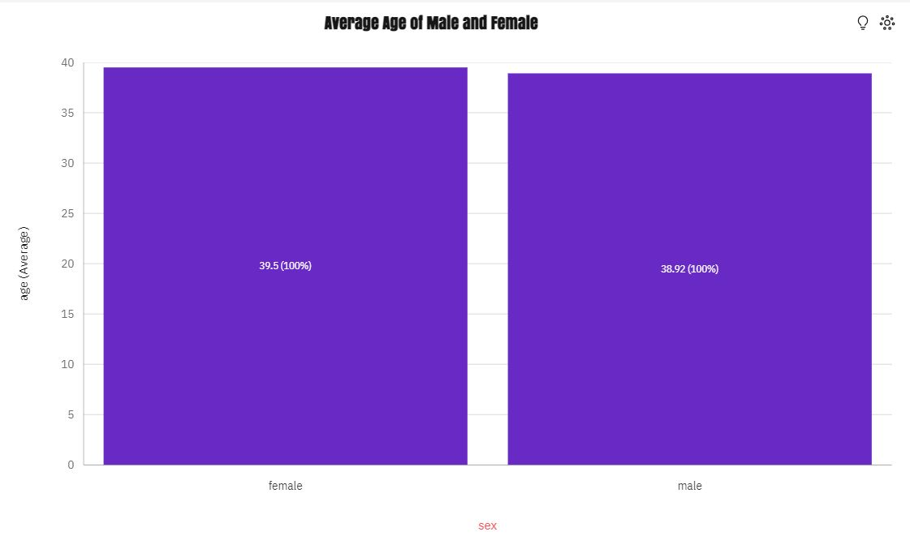
Medical Care Costs Story
From the Chart, The average age of female is higher than the male.
This graph mainly represents the average age of males and females and as we the female average is higher
The average age of female is higher despite having a little bit less number of females in the overall dataset.

Slide 12
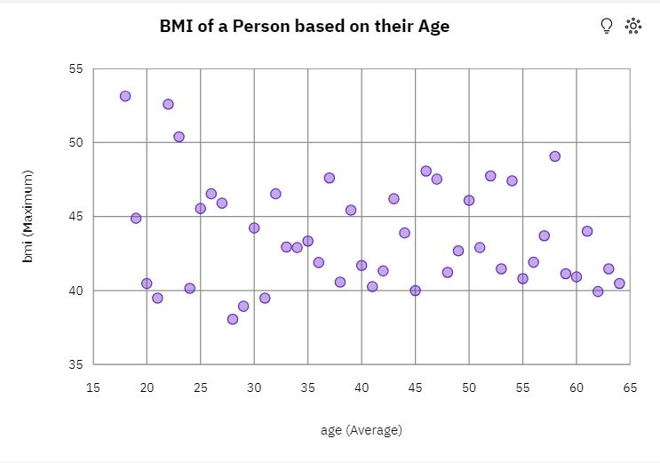
Medical Care Costs Story
In the beside graph, As the age is increasing the average BMI of persons also increases. this means BMI and age are linearly proportional.
The maximum value of BMI by is like in middle age group it's little bit higher but is age increases the BMI value is getting decreased.

Slide 13
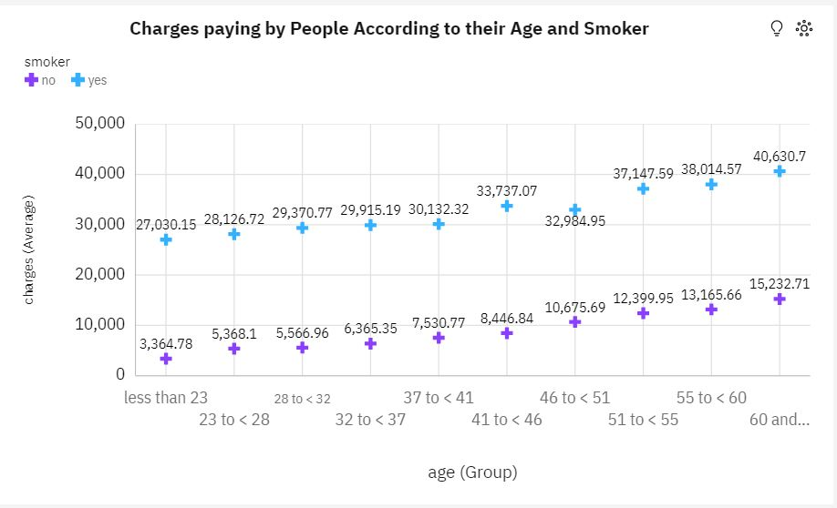
Medical Care Costs Story
Charges are getting increased as the age is also increasing in both scenarios.
Smokers of any age are paying more than non-smokers, value is also almost 3 to 5x higher.

Slide 14
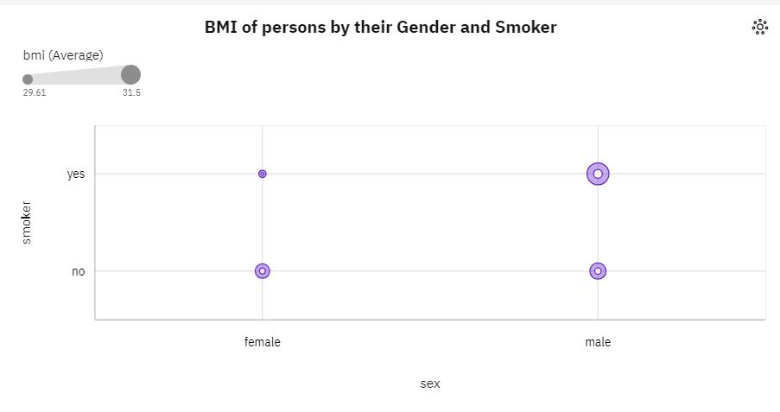
Medical Care Costs Story
Males and Smokers have the highest average BMI value compared to all.
Females and Smokers have the less average BMI value compared to all.
Incase non-smokers irrespective of gender their average BMI is almost similar.

Slide 15
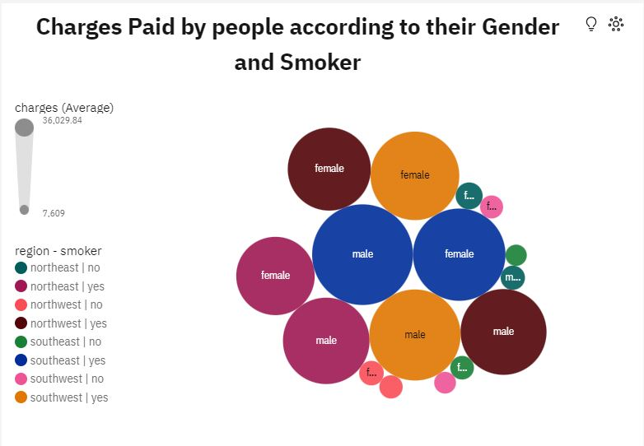
Medical Care Costs Story
South-East region smokers are the ones who Pays the more charges.
South-East region people, Both male and Female paying more charges comparing to all other region people.
Out of all we have seen smokers tend to pay more irrespective of region.

